Slide 1

Healthcare : Persistency of a Drug Final Project
Virtual Internship
Devin Chau, Ethan Dy, Rohan Khatri

Slide 2
GitHub Repo
https://github.com/ethan05d/DataGlacier-Internship/tree/main/Week%2013

Slide 3
Healthcare: Persistency of a Drug
Group Members | Devin Chau | Ethan Dy | Rohan Khatri
Email | chau.devin031602@gmail.com | ethan05dy@gmail.com | rohankhatri0507@gmail.com
Country | United States | United States | United States
Specialization | Data Science | Data Science | Data Science
Internship Batch | LISUM39 | LISUM39 | LISUM39
Date | 30 January 2025 | 30 January 2025 | 30 January 2025

Slide 4

Agenda
Problem Statement
Data Information
Data Understanding
Exploratory Data Analysis (EDA)
Recommendations

Slide 5
Problem Statement
Context:
One of the challenge for all Pharmaceutical companies is to understand the persistency of drug as per the physician prescription. To solve this problem ABC pharma company approached an analytics company to automate this process of identification. With an objective to gather insights on the factors that are impacting the persistency, build a classification for the given dataset.
Problem Description:
We are building a predictive model that classifies patients into “persistent” or “non-persistent” categories based on factors like their demographics, medical history, physician characteristics, and treatment details. Factors like the patient level such as their age, risk factors, previous test results, or provider type allows for insights into why some patients continue therapy while others drop off. Thus understanding “persistence” levels. By analyzing these data points and finding patterns, the predictive model helps explain patient behavior and supports the creation of targeted interventions to improve adherence.

Slide 6
Data Information
Total number of observations | 3424
Total number of files | 1
Total number of features | 69
Base format of the file | .csv
Size of the data | 891 KB

Slide 7
Data Information
Bucket | Variable | Variable Description
Unique Row Id | Patient ID | Unique ID of each patient
Target Variable | Persistency_Flag | Flag indicating if a patient was persistent or not
Demographics | Age | Age of the patient during their therapy
 | Race | Race of the patient from the patient table
 | Region | Region of the patient from the patient table
 | Ethnicity | Ethnicity of the patient from the patient table
 | Gender | Gender of the patient from the patient table
 | IDN Indicator | Flag indicating patients mapped to IDN

Slide 8
Data Information
Provider Attributes | NTM - Physician Specialty | Specialty of the HCP that prescribed the NTM Rx
 | NTM - T-Score | T Score of the patient at the time of the NTM Rx (within 2 years prior from rxdate)
 | Change in T Score | Change in Tscore before starting with any therapy and after receiving therapy (Worsened, Remained Same, Improved, Unknown)
 | NTM - Risk Segment | Risk Segment of the patient at the time of the NTM Rx (within 2 years days prior from rxdate)
 | Change in Risk Segment | Change in Risk Segment before starting with any therapy and after receiving therapy (Worsened, Remained Same, Improved, Unknown)
 | NTM - Multiple Risk Factors | Flag indicating if patient falls under multiple risk category (having more than 1 risk) at the time of the NTM Rx (within 365 days prior from rxdate)

Slide 9
Data Information
Clinical Factors
NTM - Dexa Scan Frequency | Number of DEXA scans taken prior to the first NTM Rx date (within 365 days prior from rxdate)
NTM - Dexa Scan Recency | Flag indicating the presence of Dexa Scan before the NTM Rx (within 2 years prior from rxdate or between their first Rx and Switched Rx; whichever is smaller and applicable)
Dexa During Therapy | Flag indicating if the patient had a Dexa Scan during their first continuous therapy
NTM - Fragility Fracture Recency | Flag indicating if the patient had a recent fragility fracture (within 365 days prior from rxdate)
Fragility Fracture During Therapy | Flag indicating if the patient had fragility fracture during their first continuous therapy
NTM - Glucocorticoid Recency | Flag indicating usage of Glucocorticoids (>=7.5mg strength) in the one year look-back from the first NTM Rx
Glucocorticoid Usage During Therapy | Flag indicating if the patient had a Glucocorticoid usage during the first continuous therapy
NTM - Injectable Experience | Flag indicating any injectable drug usage in the recent 12 months before the NTM OP Rx
NTM - Risk Factors | Risk Factors that the patient is falling into. For chronic Risk Factors complete lookback to be applied and for non-chronic Risk Factors, one year lookback from the date of first OP Rx

Slide 10
Data Information
Data Information
Disease/Treatment
Factor
NTM - Comorbidity | Comorbidities are divided into two main categories - Acute and chronic, based on the ICD codes. For chronic disease we are taking complete look back from the first Rx date of NTM therapy and for acute diseases, time period before the NTM OP Rx with one year lookback has been applied
NTM - Concomitancy | Concomitant drugs recorded prior to starting with a therapy(within 365 days prior from first rxdate)
Adherence | Adherence for the therapies

Slide 11
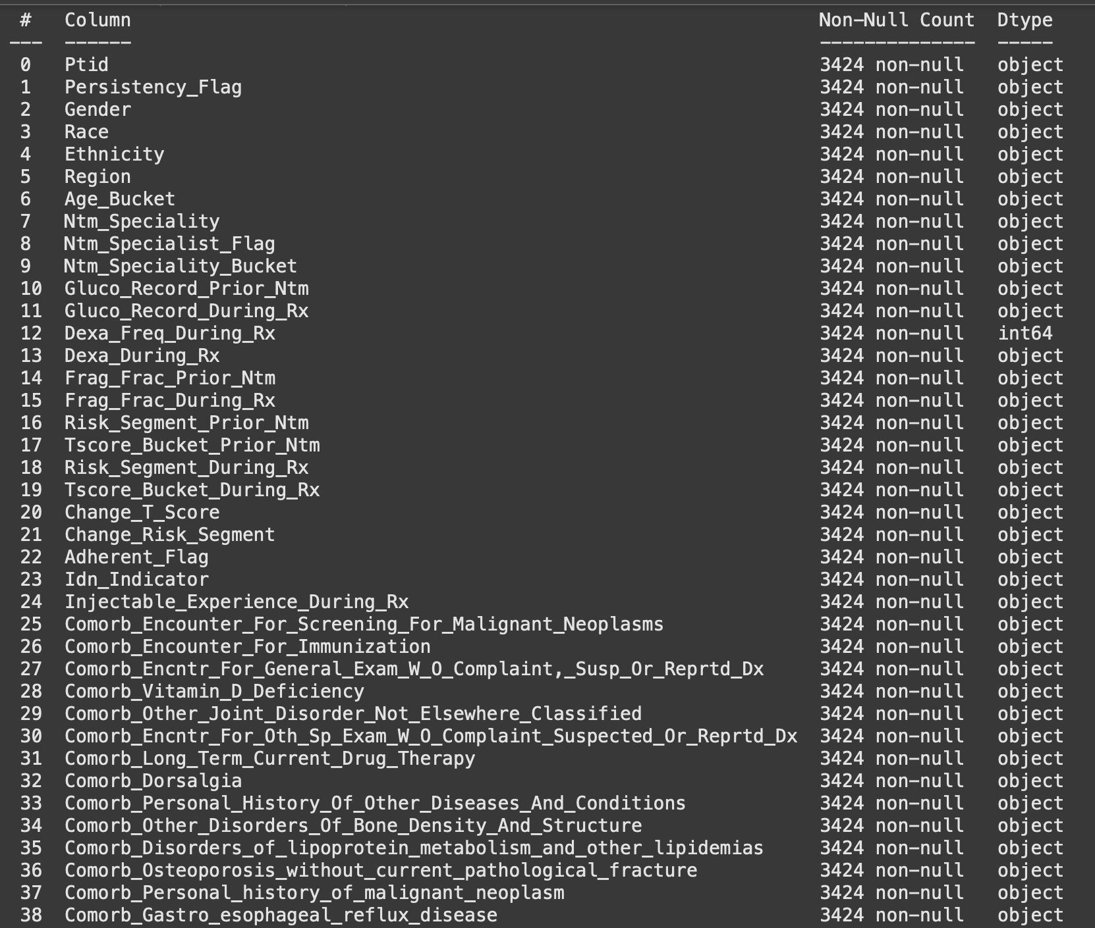
Data Information
Data Understanding
The dataset consists of 3424 rows and 69 columns
Types of Variables
Numeric (2 columns):
Dexa_Freq_During_Rx
Count_Of_Risks
Categorical (67 columns):
Examples: Persistency_Flag, Gender, Ntm_Speciality, etc
Many are binary flags (Y/N, etc.), while some have multiple categories (e.g., Ntm_Speciality has 36)
Multiple columns (such as Risk_Segment_During_Rx, Change_T_Score, etc.) contain a large number of “Unknown” entries. This shows hidden missing data that could influence model training and interpretation

Slide 12
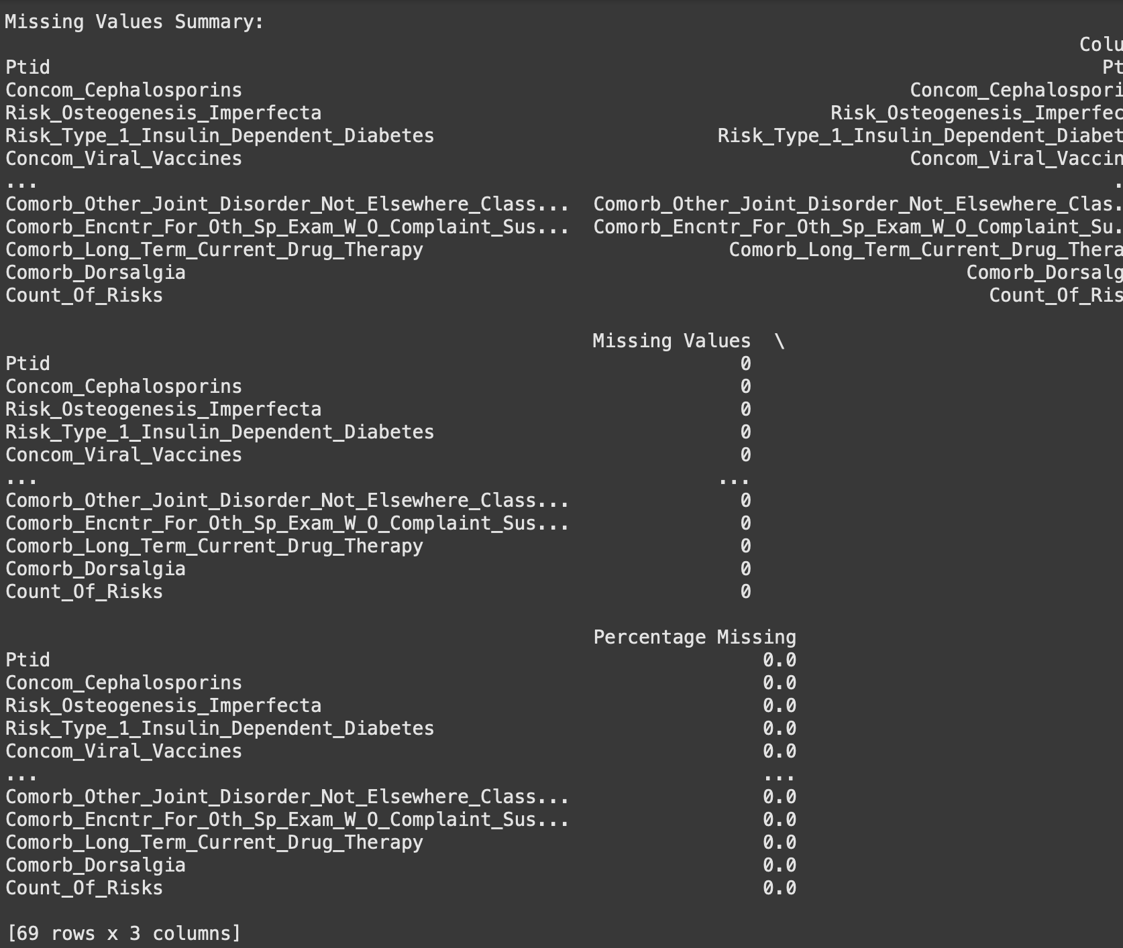
Data Information
Data Understanding
Hidden “Unknown” Data
Some columns use the string "Unknown" instead of NaN. Like, Risk_Segment_During_Rx, Change_T_Score, and others have a lot of "Unknown" entries
Outliers:
Two numeric variables, Dexa_Freq_During_Rx and Count_Of_Risks, have outliers:
Dexa_Freq_During_Rx shows 460 outliers (based on the Interquartile Range method)
Count_Of_Risks shows 8 outliers (also IQR-based)

Slide 13
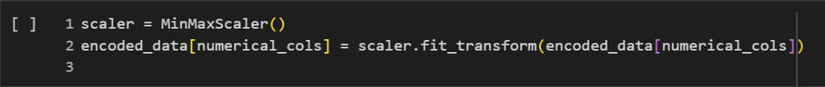
Data Information
Data Understanding
MinMaxScaler was used to normalize numerical columns, bringing all variables to a common scale and ensuring equal contribution to the model.
Feature Scaling:
Scaled numerical features using MinMaxScaler to normalize their range, ensuring model fairness.
Duplicate rows were detected based on the 'PatientID' column to prevent skewed analyses, and they were logged for further review.
Columns were standardized to appropriate data types, reducing potential errors during analysis.

Slide 14
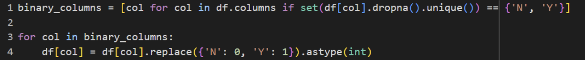
Data Information
Data Understanding
Outlier Handling:
Removed outliers from the Dexa_Freq_During_Rx column by excluding entries where its value was zero.
Binary Encoding:
Converted categorical binary values ('N' and 'Y') into numerical representations (0 and 1), ensuring compatibility with classifier models.

Slide 15
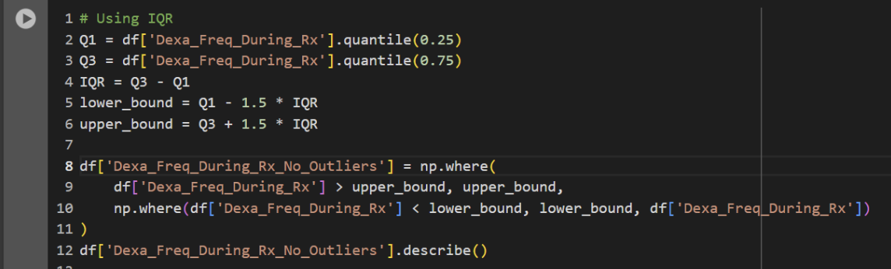
Data Information
Data Understanding
Outlier Handling:
Applied the IQR method to cap extreme values within acceptable ranges, addressing potential data skew.

Slide 16
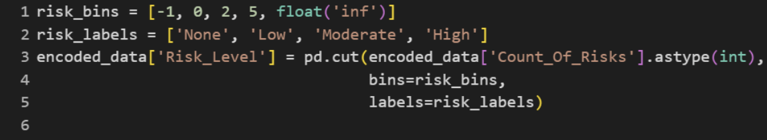
Data Information
Data Understanding
Risk Level Encoding:
Categorized patient risk levels into bins such as 'None', 'Low', 'Moderate', and 'High' based on Count_Of_Risks values, enabling targeted risk analysis.

Slide 17
Data Information
Exploratory Data Analysis (EDA)
During the exploratory data analysis (EDA), we performed the following steps:
Data Visualization: Visualized distributions of numerical features such as Dexa_Freq_During_Rx and Count_Of_Risks.
Histograms showed high skewness in Dexa_Freq_During_Rx, leading to the decision to apply log transformation for normalization
Correlation Analysis: Calculated correlations between numerical variables. Count_Of_Risks showed a moderate correlation with the target variable Persistency_Flag
Categorical Feature Inspection: Explored distributions for categorical variables like Ntm_Speciality and Gender. Identified the imbalanced classes in Ntm_Speciality which could maybe lead to overfitting (?)
Outlier Detection: Used the Interquartile Range (IQR) method to detect outliers. Dexa_Freq_During_Rx had 460 extreme values,
while Count_Of_Risks had 8 outliers (addressed using capping methods)
Handling Missing Values: Discovered multiple columns with the value "Unknown" instead of NaNs, indicating hidden missing data. Handled as separate categories

Slide 18
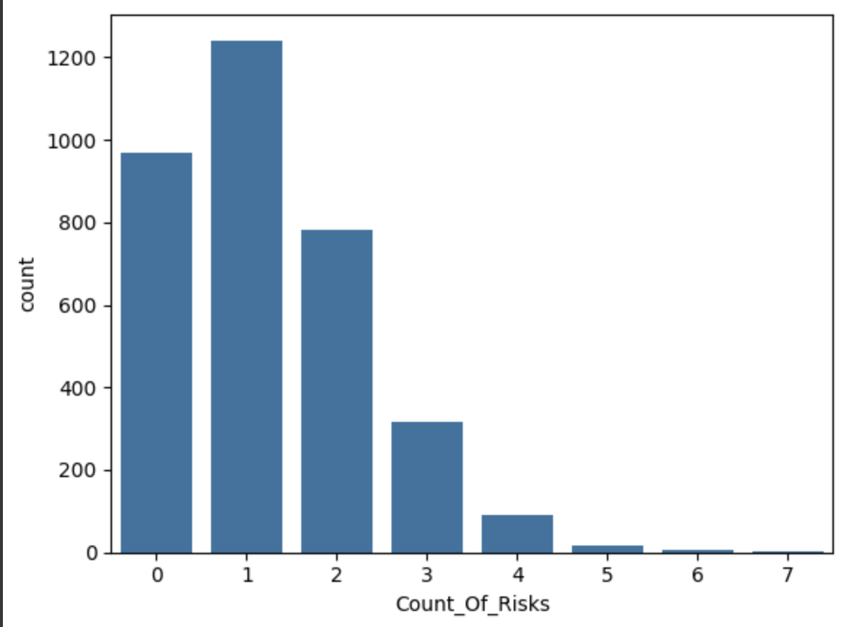
Data Information
Exploratory Data Analysis (EDA)
As we can see, most people tend to have 0-2 counts of risk in total, which is good to see. It is better to see less counts of risks in comparison to the higher numbers.

Slide 19
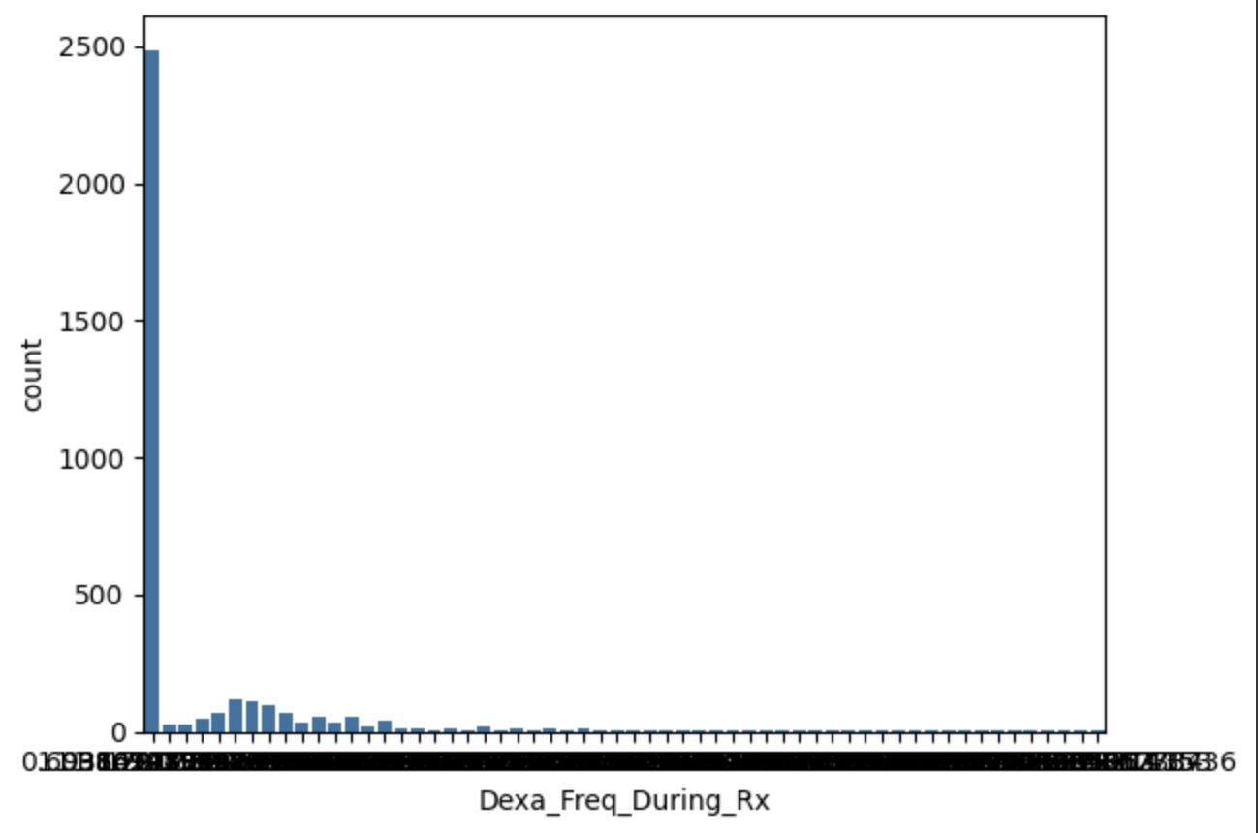
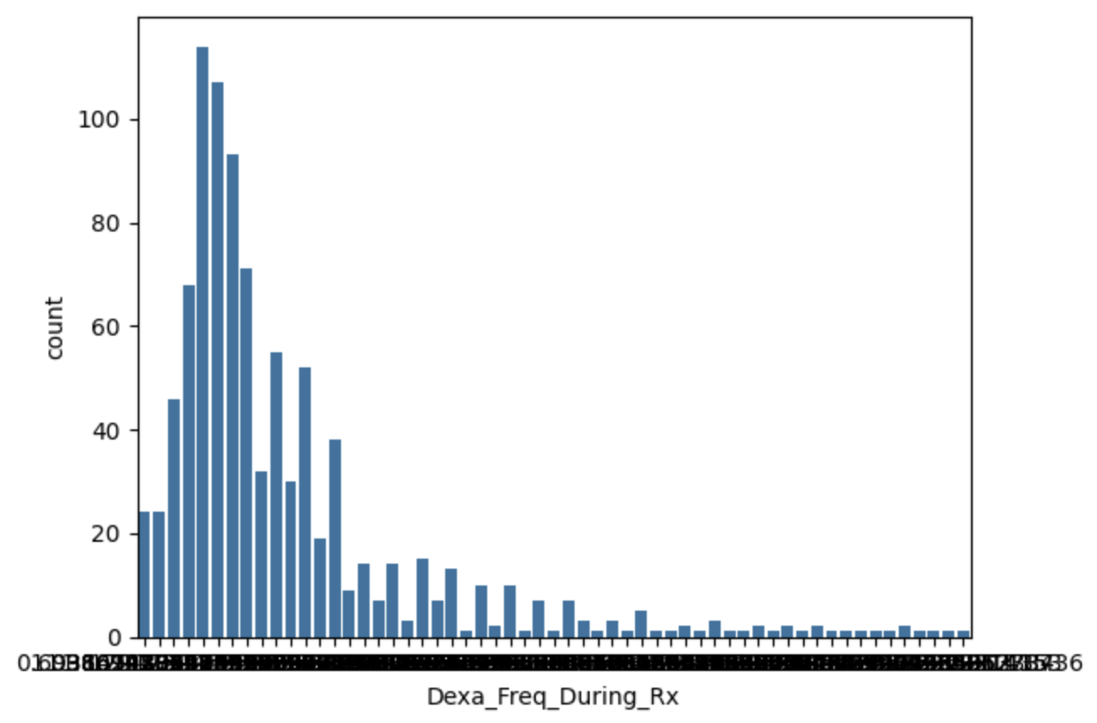
Data Information
Exploratory Data Analysis (EDA)
This is what the distribution looks like without the outlier of 0

Slide 20
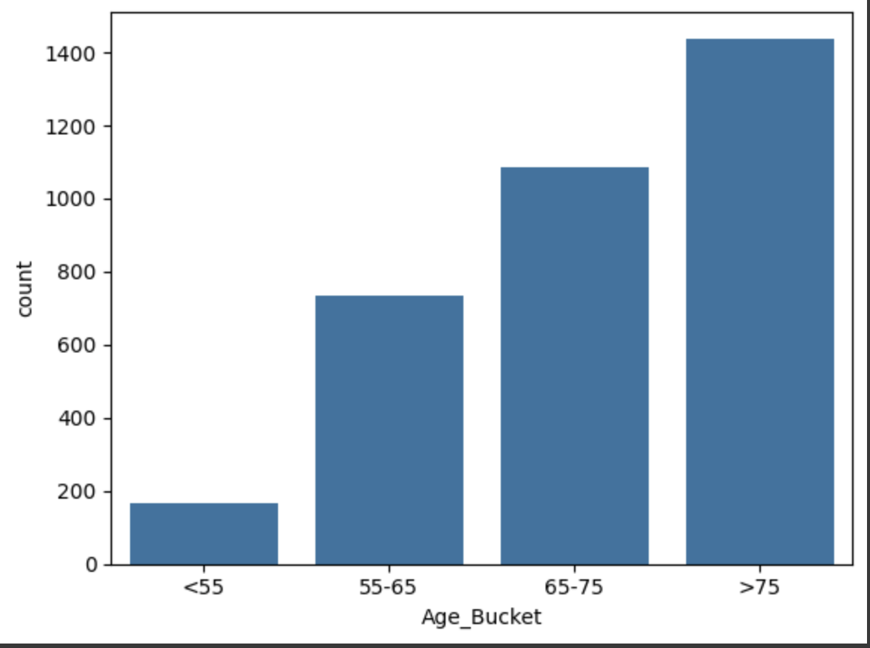
Data Information
Exploratory Data Analysis (EDA)
The largest proportion of patients reported in this dataset belongs to the older age group, specifically those aged >75.

Slide 21
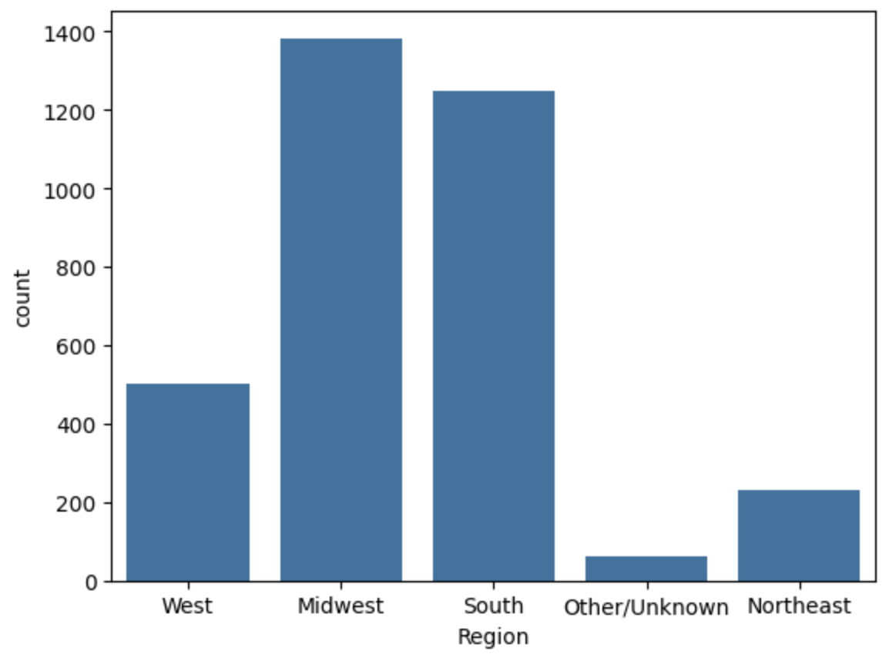
Data Information
Exploratory Data Analysis (EDA)
Northeast and West seem to be severely underreported as compared to Midwest and South Region

Slide 22
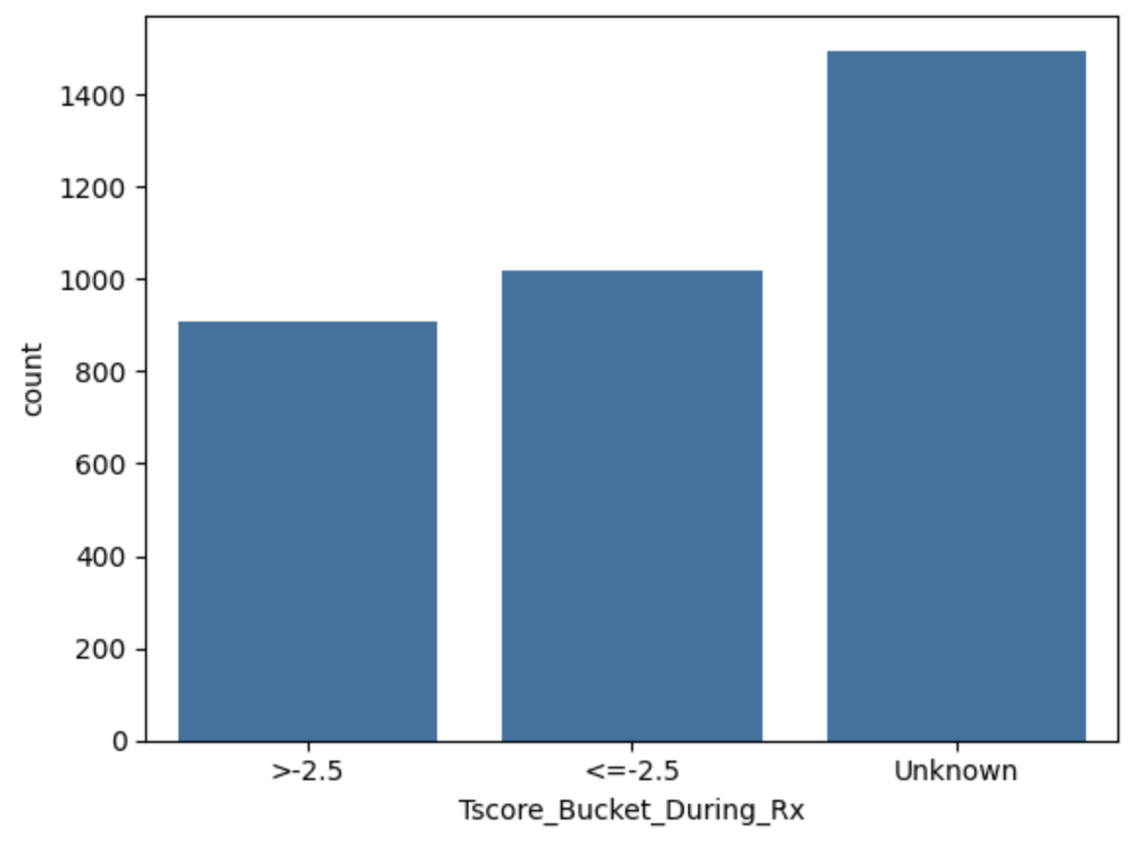
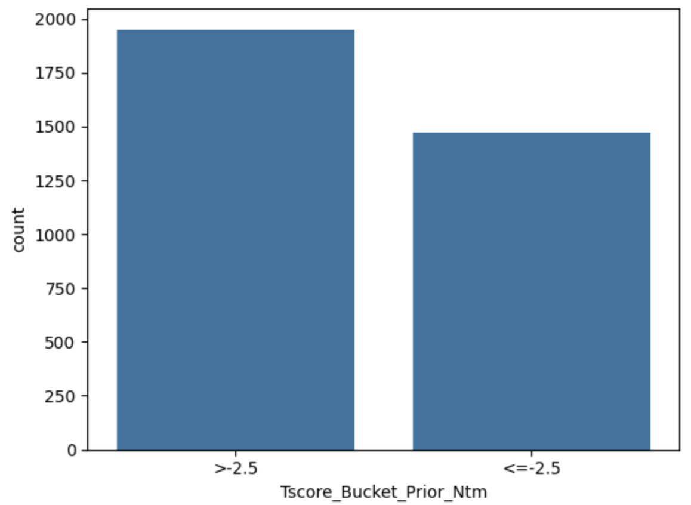
Data Information
Exploratory Data Analysis (EDA)

Slide 23
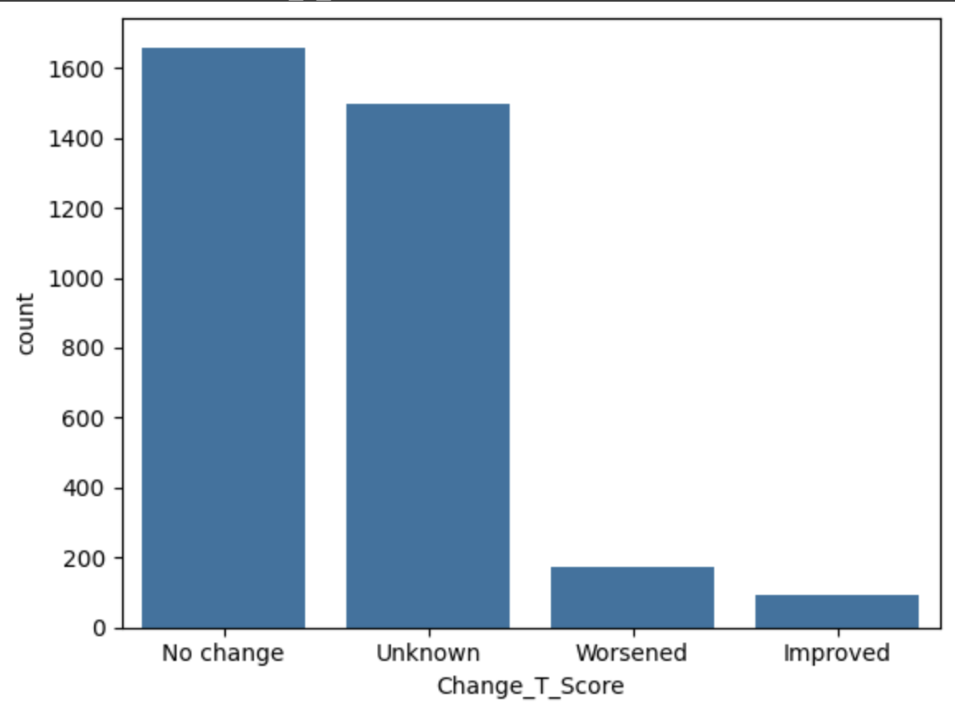
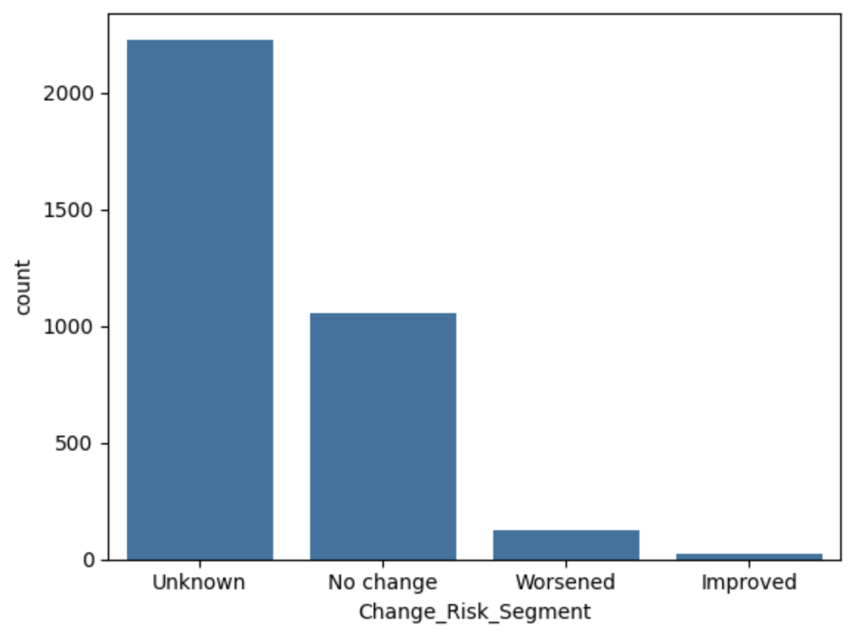
Data Information
Exploratory Data Analysis (EDA)
We can see that typically there is no change. Worsened more than improved in terms of change risk segment.

Slide 24
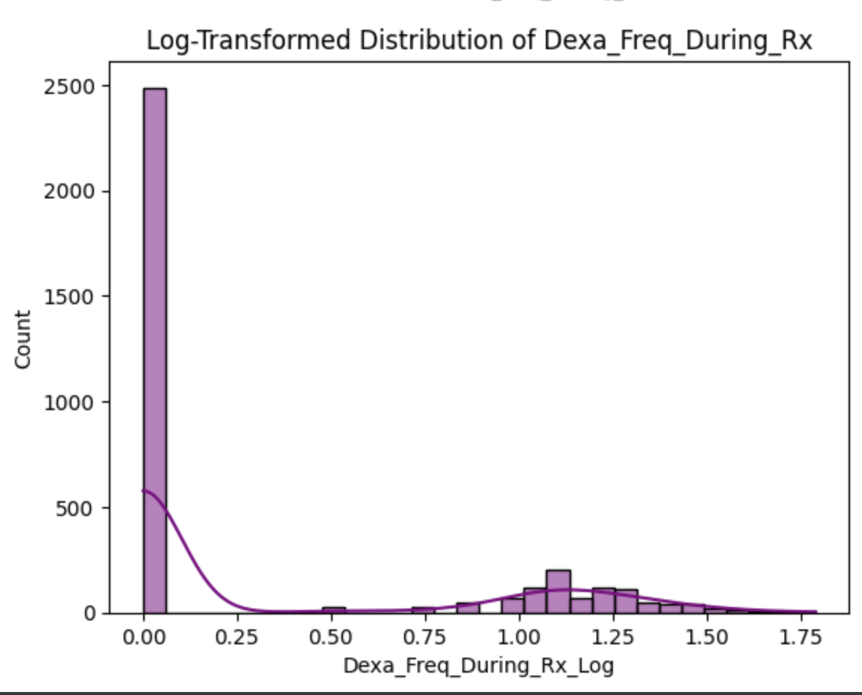
Data Information
Exploratory Data Analysis (EDA)
Log transformation to Dexa_Freq_During_Rx for normalization

Slide 25
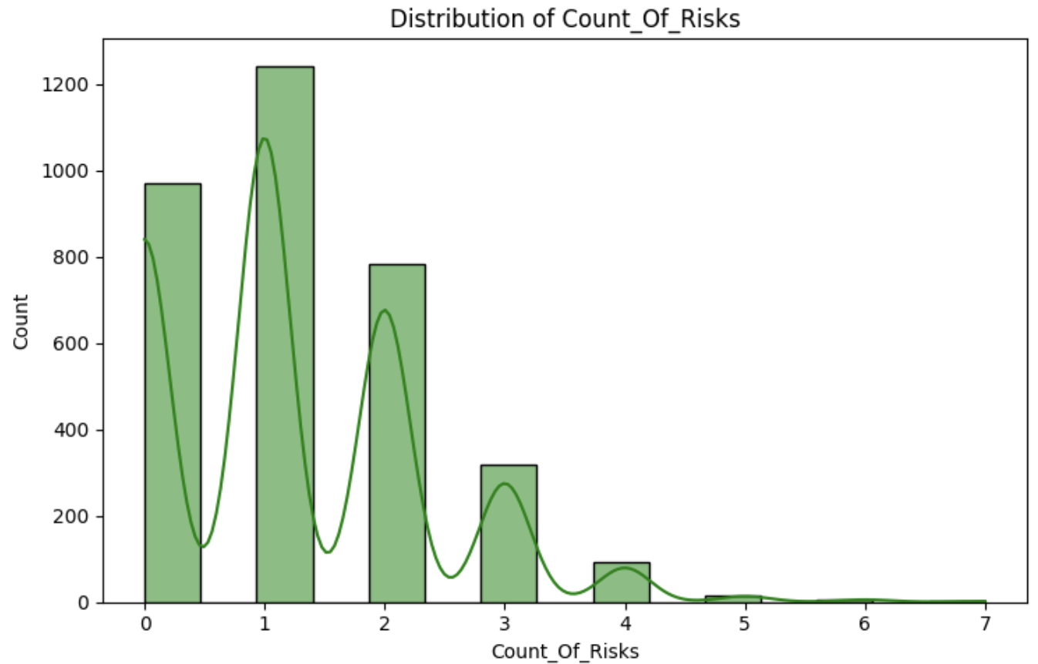
Data Information
Exploratory Data Analysis (EDA)
Histogram for Count_Of_Risks

Slide 26
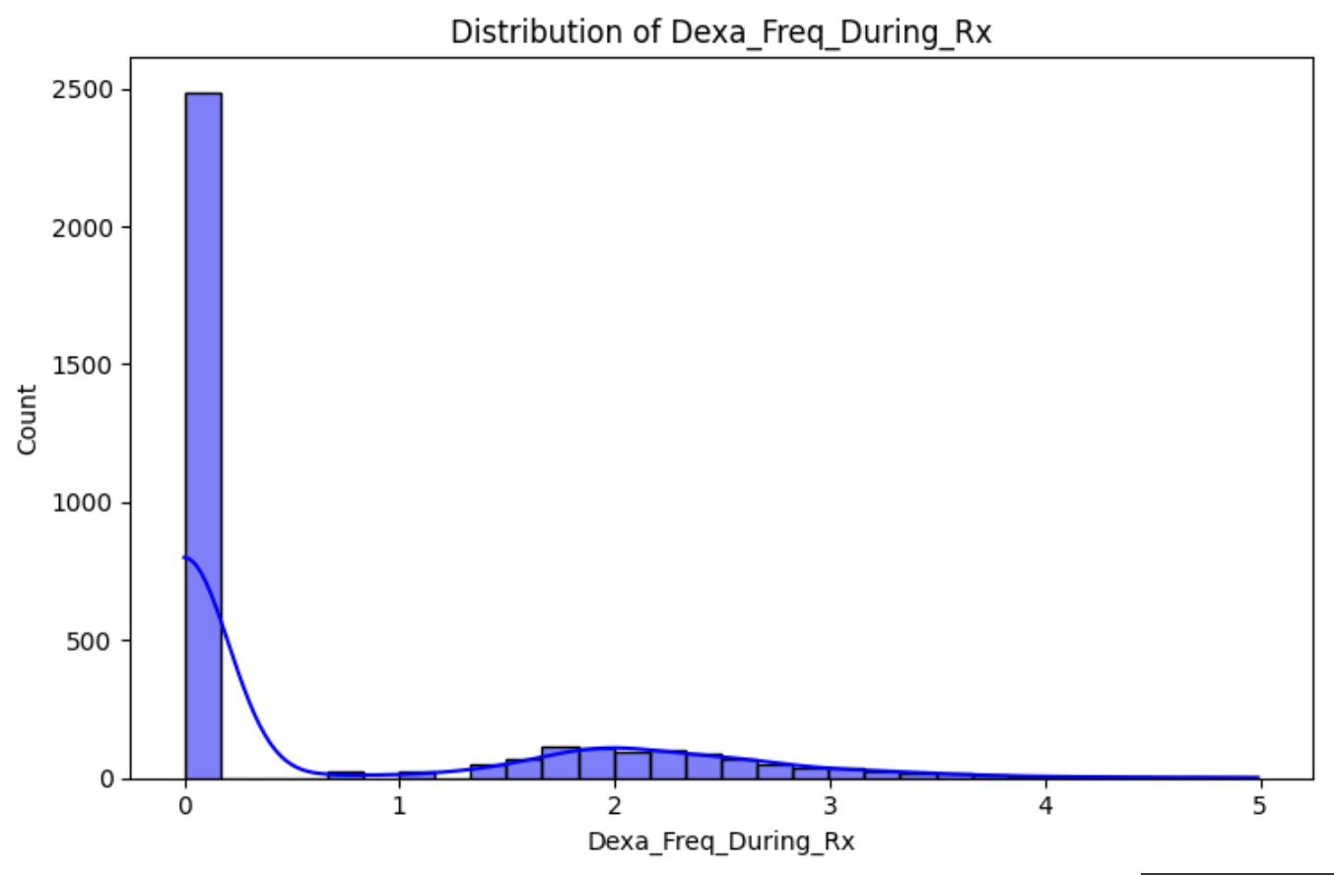
Data Information
Exploratory Data Analysis (EDA)
Histogram for normalized Dexa_Freq_During_Rx

Slide 27
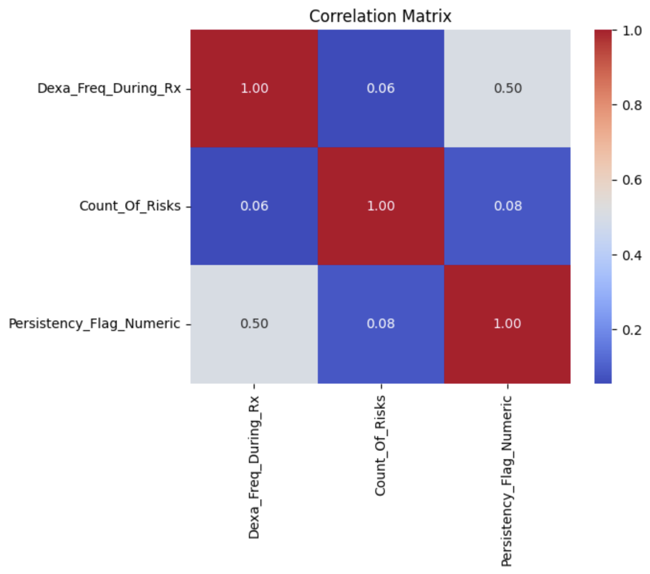
Data Information
Exploratory Data Analysis (EDA)
The variables are mostly uncorrelated except for a moderate relationship between Dexa_Freq_During_Rx and Persistency_Flag_Numeric.
Higher Dexa scan frequency might be slightly associated with better persistence in treatment adherence.
Count of risks does not show a meaningful correlation with either of the other variables.

Slide 28
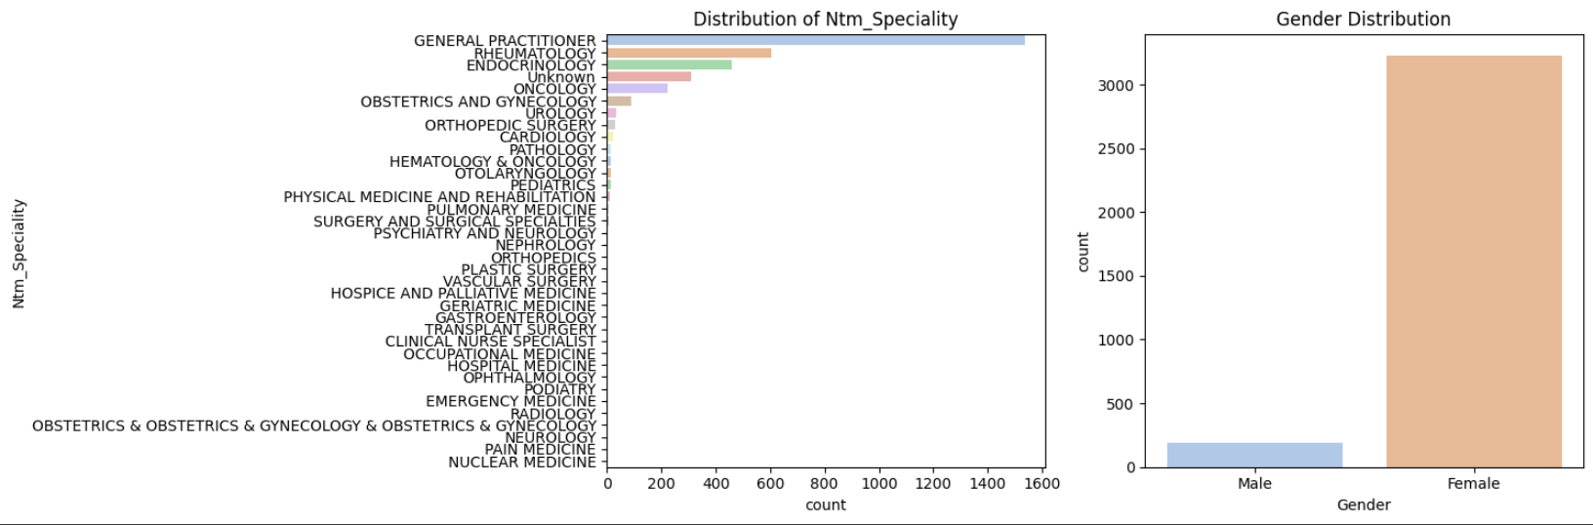
Data Information
Exploratory Data Analysis (EDA)
The data suggests that most observations come from general practitioners and predominantly female participants.
The gender imbalance might influence study outcomes if gender plays a role in the analysis being conducted.

Slide 29
Data Information
Exploratory Data Analysis (EDA)
Final Recommendations
Based on the analysis and identified data issues, we recommend:
Handling Missing Values: Maintain “Unknown” entries as a separate category to preserve data integrity and avoid loss of potentially valuable patterns
Normalization: Continue using MinMaxScaler for numerical features like Dexa_Freq_During_Rx and Count_Of_Risks to ensure consistent scaling across variables
Outlier Handling: Use the IQR method to cap extreme values for Dexa_Freq_During_Rx and Count_Of_Risks
Categorical Encoding: Apply one-hot encoding for categorical variables with multiple categories. Using binary encoding for columns with simple Y/N values
Feature Engineering: Consider grouping rare categories in columns like Ntm_Speciality to avoid overfitting due to high cardinality
Data Consistency: Ensure proper standardization of data types and consistency across the entire dataset before model training

Slide 30
Data Information
Exploratory Data Analysis (EDA)
Recommended models for this datasets:
Logistic Regression:
For binary classification.
Decision Trees:
Easy to interpret and handle categorical variables directly.
Random Forest:
Robust and simple, handling mixed data types well.
We will probably look into random forest more so than decision trees

Slide 31

Data Information
Recommendations
Our recommendations for this is to have a model be built using XGBoost to classify patients into “persistent” or “non-persistent” categories
XGBoost (Extreme Gradient Boosting) is a great choice for this problem as it includes L1 and L2 regularization to avoid overfitting which could occur from this type of problem.
XGBoost also uses max depth approach which helps with overfitting

Slide 32
Data Information
Recommendations (cont).
XGBoost worked well during training and testing
However, it could be improved upon as our accuracy was below 80%. We wish to optimize the model to give accurate predictions
Future Endeavors
In the future, we look to add possibly more models, specifically models using ensemble learning techniques, and combine it with XGBoost to improve efficiency and accuracy.
Some possible techniques for the future would be:
Blending models, bagging, or have an autoencoder create new features

Slide 33
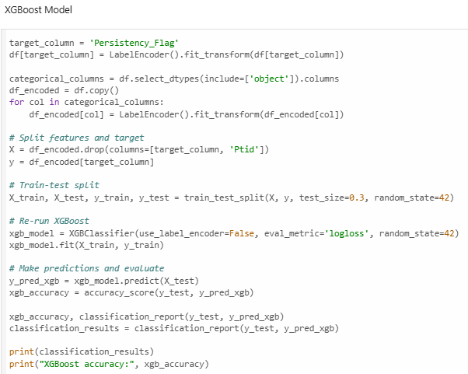
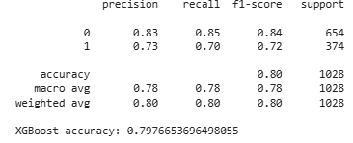
Data Information
Demonstration of the Code

Slide 34
Thank You

